Slide 1
Lipids, Structure and Properties

Slide 2
Quiz Question 1
Which lipid is essential in the human diet
Cholesterol
Linoleate (18:2ω6)
Palmitate (16:0)
Oleate (18:1)
Notes:
B

Slide 3
Quiz Question 2
For polyunsaturated fatty acids how far along the chain are subsequent double bonds relative to the bond preceeding it
Double bonds are generally adjacent
Double bonds are generally two carbons farther along
Double bonds are generally three carbons farther along
Double bonds are generally four carbons farther along

Slide 4
Quiz Question 3
What does amphipathic mean?
A lipid has a hydrophilic and hydrophobic part
A fatty acid has multiple double bonds
Two different acyl chains are added to a glycerol head group
The lipid can sense what you are feeling right now

Slide 5
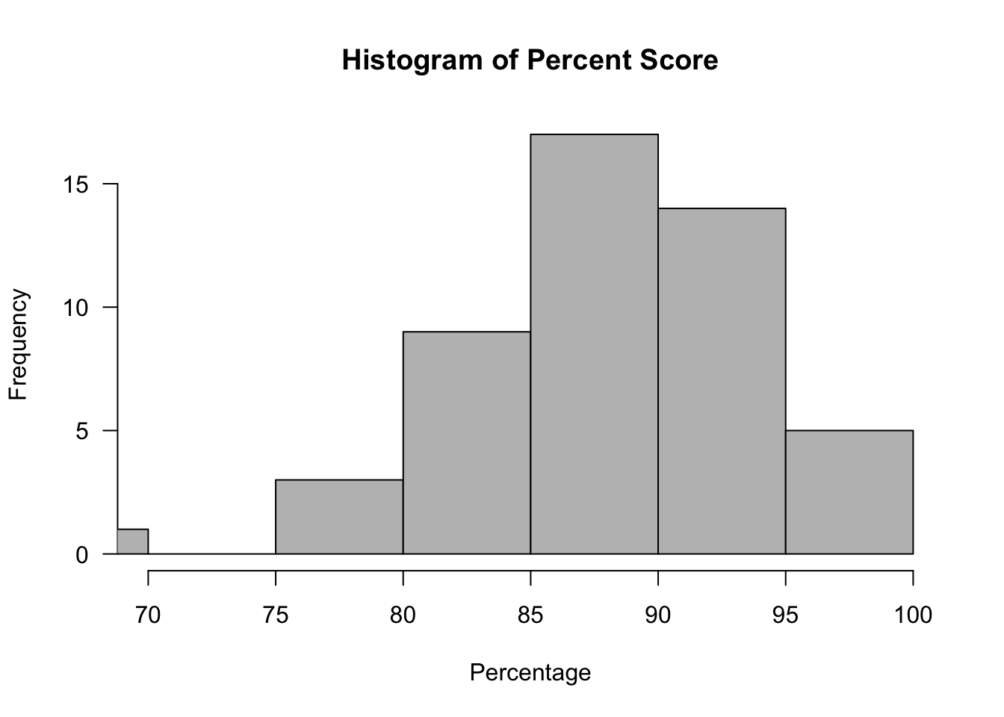
Midterm Exam
Median 89
Mean 87

Slide 6
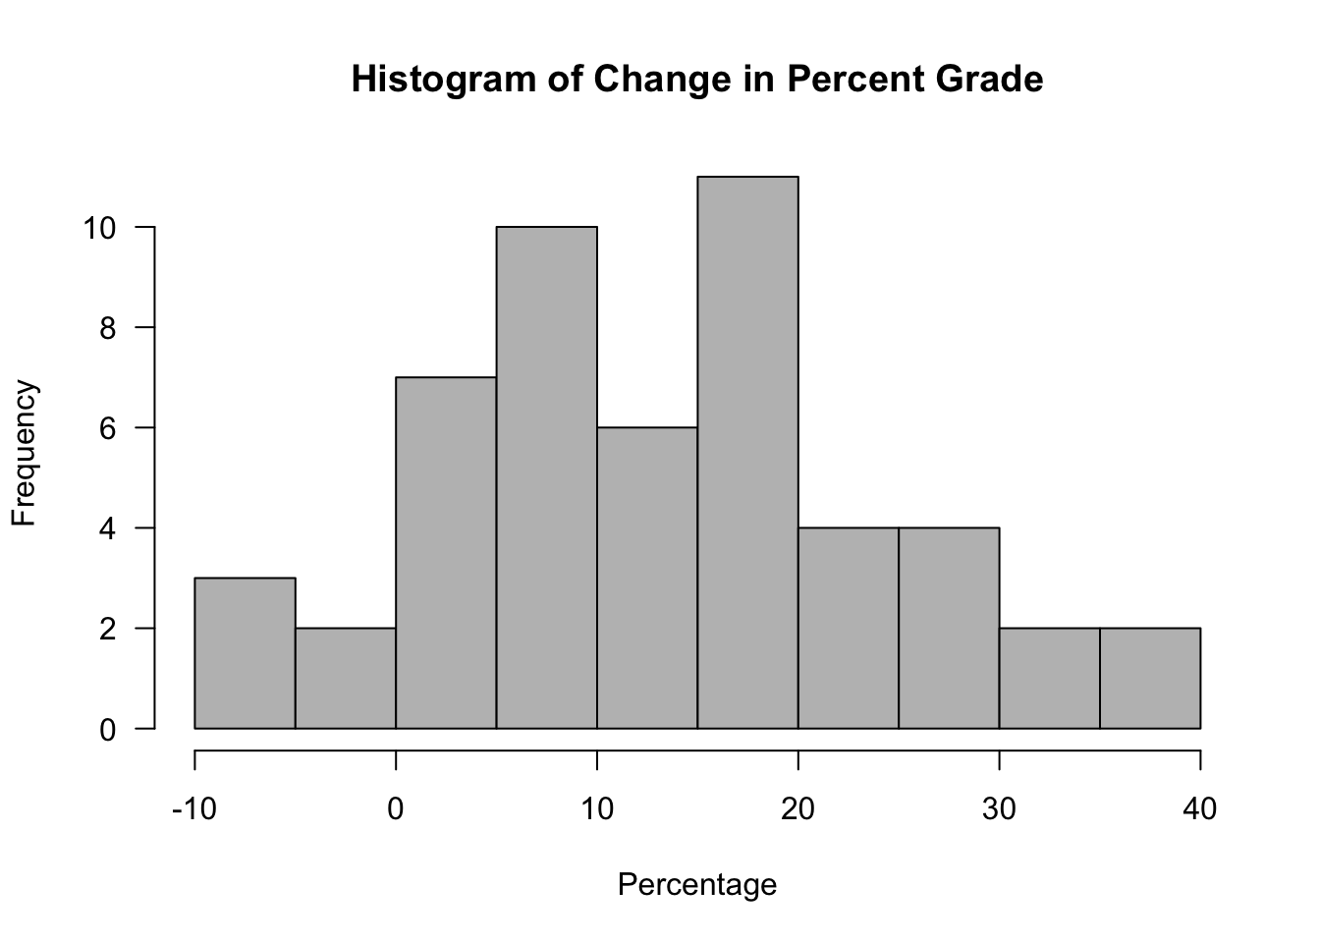
Class-wide Improvements
47/51 had a higher grade this midterm
Average improvement of 14% or 41 points
12 students improved by >20%
First ever perfect score on a midterm I wrote!

Slide 7
Final Grading Notes
All protein unit assignments have been graded
If you have not received a grade for something, let Rina know as soon as possible
Now is a good time to re-evaluate your plan on GradeCraft
Exams will be handed back at the end of class
Please check the adding of your exam and submit any questions to Rina before Thanksgiving break

Slide 8
Learning Objectives
Understand the different roles of lipids in our bodies
Describe the structure and functions of triacylglycerols (triglycerides)
Recognize that phospholipids are amphipathic and play an important role as structural components within our body
Identify the structure and functions of cholesterol and other steroids
Use the common, n- and w nomenclature systems to describe fatty acids, and be able to draw fatty acids based on these various naming systems
Describe the structure of fatty acids and analyze how this affects their packing, solubility and physical state
Explain the roles of the essential fatty acids, including what makes them essential

Slide 9
Roles of lipids
Lipids have many functions in body
Structural and functional components of cells
Inflammatory response
Hormone production
Energy source
Insulation
Recommendations: 20-35% of energy intake per day (IOM Guidelines 2010)

Slide 10
Types of Lipids
Triglycerides
Phospholipids
Sterols

Slide 11
Structure of Sterols
Cholesterol
Fatty Acid Ester
(in this case oleic acid)
Cholesterol Ester

Slide 12
Role of cholesterol in cells
Component of cell membranes, enhances membrane fluidity
Pre-cursor to many bodily compounds
Bile salts
Hormones: estrogen, androgen, progesterone
Vitamin D
Not essential, can be made by cells

Slide 13
Phospholipids as amphipathic barriers
Notes:
Point out that this is phosphatidylcholine

Slide 14
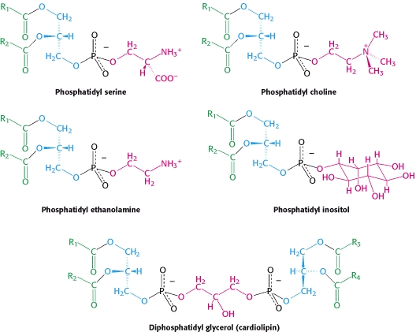
Structure of Phospholipids
Notes:
Head groups matter!

Slide 15
Choline Deficiency
A major phospholipid is phosphatidylcholine
Choline is a micronutrient used for methylation reactions
Humans can (barely) make it, so it is semi-essential, also important during pregnancy.
Deficiency can result in:
Developmental defects
NAFLD
Anxiety
Notes:
90% of people on earth are “choline deficient”
Classified as essential nutrient in 1998

Slide 16
Nutrigenomics and choline
Subjects were randomized into choline deficient diets
Monitored for signs of deficiency
Liver fat
Muscle breakdown
Variants in single-nucleotide polymorphisms of PEMT associated with responses to choline deficiency (OR: 25 in women)
28% of the population have this allele
da Costa K-A, Kozyreva OG, Song J, Galanko J A, Fischer LM, Zeisel SH. Common genetic polymorphisms affect the human requirement for the nutrient choline. FASEB J 2006; 20:1336–44.

Slide 17
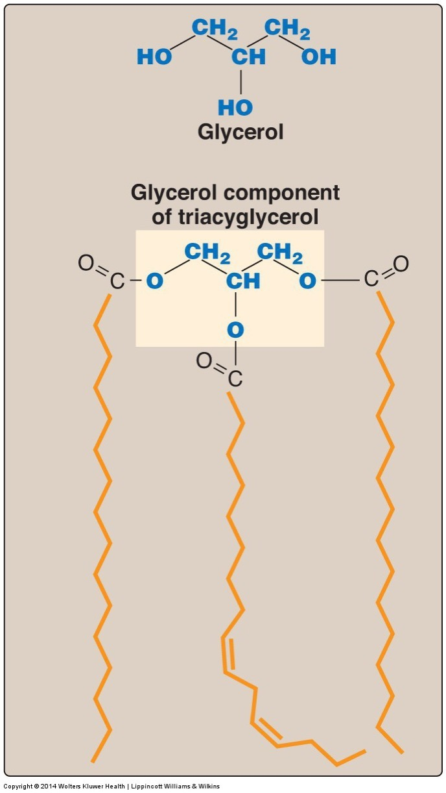
Structure of Triglycerides
95% of human fat
Largest energy store in the body
Glycerol backbone with three acyl groups
Stored with cholesterol in lipid droplets

Slide 18
Fatty Acid Nomenclature

Slide 19
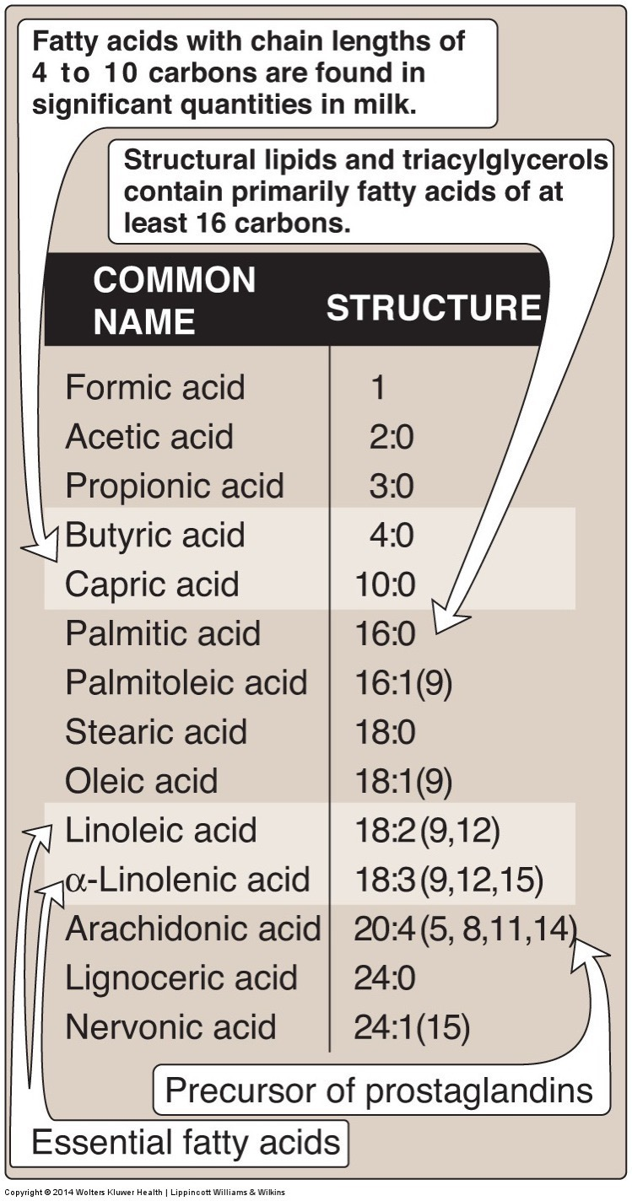
Fatty Acid Classification
Classification based on length
Short Chain < 6
Medium Chain 6-12
Long Chain 13-21
Very Long Chain 22+
Classification based on saturation (double bonds)
Saturated Fatty Acids
Monounsaturated Fatty Acids
Polyunsaturated Fatty Acids

Slide 20
Fatty Acid Structure/Function Notes
 | Effects
Shorter vs Longer | Longer has more energy Longer tends to be solid
Saturation vs desaturation | Desaturated less energy Desaturated more liquid Desaturated more prone to oxidation

Slide 21
Short Chain Fatty Acids are Derived in Gut
Derived from fiber
Will discuss this more next lecture

Slide 22
Medium Chain Fatty Acids
Shorter therefore more easily metabolized than long chain fatty acids
High in palm kernel and coconut oil
Generally saturated
Metabolized by intestinal cells and traffics straight to liver
Will discuss this in lecture on digestion

Slide 23
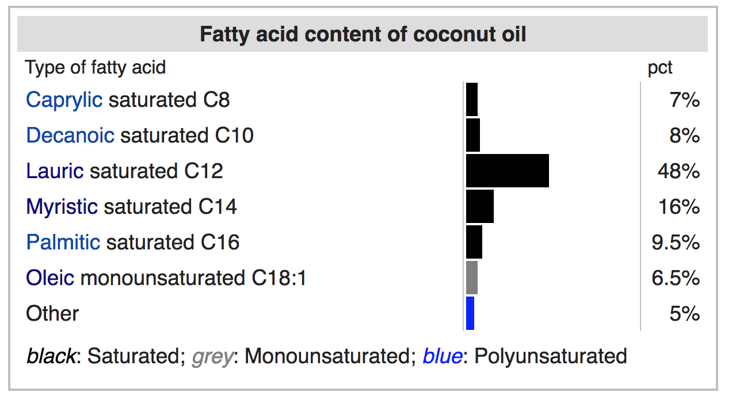
Composition of coconut oil
https://en.wikipedia.org/wiki/Coconut_oil

Slide 24
Saturated and Unsaturated Fatty Acids
Saturated Fatty Acids
Monounsaturated Fatty Acids (MUFA)
Polyunsaturated Fatty Acids (PUFA)

Slide 25
Effects of dietary fatty acid composition
Wang DD, Li Y, Chiuve SE, Stampfer MJ, Manson JE, Rimm EB, Willett WC, Hu FB. Association of Specific Dietary Fats With Total and Cause-Specific Mortality. JAMA Intern Med. 2016; 176: 1134–45. doi: 10.1001/jamainternmed.2016.2417.

Slide 26
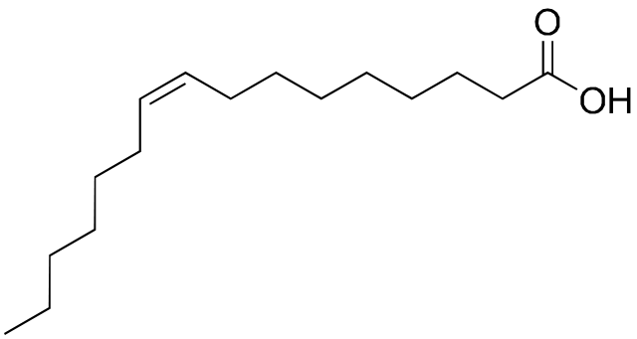
Nomenclature of Unsaturated Fatty Acids
Common name (Palmitate, Linoleate, etc)
Lipid numbers
N:D where:
N is the length of the chain
D is the number of double bonds
Ambiguous so often combined with Delta/ n-x or ω
Delta nomenclature
Δ indicates double bond location (from acid end)
n-x or ω nomenclature
Indicates double bond location (from methyl end)
Naming Type | Example
Common Name | Palmitoleic Acid
Delta | cis-Δ⁹-Hexadecenoic acid
n-x/ω | ω7 – Hexadecenoicacid
Lipid numbers | 16:1 or 16:1 ω7
9
7
5
3
7
1
8
6
4
2
6
5
4
3
2
1

Slide 27
Naming Practice – Draw These (all cis)
Myristic acid 18:0
Palmitoleic acid 16:1 cis-Δ⁹
Docosahexaenoic acid 22:6(n-3)
Multiple desaturations separated by one carbon with single bonds on either side (3 numbers)
Elaidic acid 18:1 trans-Δ⁹
Notes:
For multiple bonds, they start at omega end, and go back every third

Slide 28
Drawn Structures

Slide 29
Cis and Trans Fats
Most occurring fatty acids are cis
Trans fats are made industrially
Can make fats solid from easily available liquid fat (vegetable oils) via partial hydrogenation
Looks more like a saturated fat

Slide 30
Health Problems Associated with Trans Fatty Acids
Increases in risk factors for cardiovascular disease
Raised LDL, cholesterol, lowered HDL
Raised triglycerides
Increased inflammation and impaired endothelial cell function
Obesity
de Souza RJ, Mente A, Maroleanu A, Cozma AI, Ha V, Kishibe T, Uleryk E, Budylowski P, Schünemann H, Beyene J, et al. Intake of saturated and trans unsaturated fatty acids and risk of all cause mortality, cardiovascular disease, and type 2 diabetes: systematic review and meta-analysis of observational studies. BMJ 2015; 351:h3978.
Notes:
Mechanism currently unknown

Slide 31
Trans fat consumption

Slide 32
Replacing trans fats with palm oil
Grows in tropics, solid at Room Temperature
44% Palmitate 16:0
38% Oleate 18:1ω9
Why is palm but not olive oil solid at room temperature?
More saturated fats
Less saturated fats
Longer chain length
Shorter chain length
Compare with:
Butter
31% Palmitate 16:0
24% Oleate 18:1ω9
12% Myristate 14:0
11% Stearate 18:0
Olive oil
71% Oleate 18:1ω9
11% Palmitoleate 18:2ω7
11% Palmitate 16:0

Slide 33
Fatty Acids in Some Common Fats
Notes:
Point out the effects of hydrogenation of cottonseet oil

Slide 34
Fat and Oil Composition Assignment
Someone needs a laptop/tablet/iPhone
Go to https://ndb.nal.usda.gov/ndb/search/list
Under Select Source select Standard Reference
Type the oil you want to study
Click on Full Report (All Nutrients)
Fill in the details on each lipid in http://bit.ly/2mkxjlW
Are there high levels of any other micronutrients in this lipid?
Calculate % SFA, MUFA, PUFA, EFA for your lipid
Pick one fat (doesn't have to be yours) and submit a ~ 1 paragraph summary on the nature (solid/liquid) and ”quality” of the fat. Submit through GradeCraft by midnight Friday

Slide 35
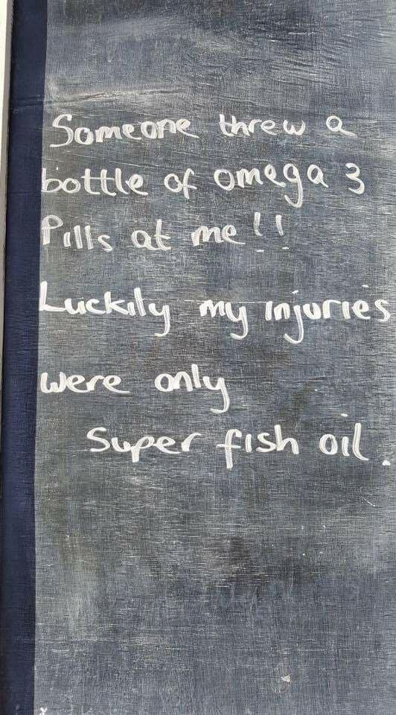

Slide 36
Desaturases and Double Bond Formation
SCD1
NOT IN HUMANS

Slide 37
Studies on “Vitamin F”
Burr M, Miller S. Fatty Acids in Nutrition. J Biol Chem 1932; 97:1–9.

Slide 38
ω3 and ω6 Fatty Acids are Essential in Humans
We have desaturates, but not any ω3 and ω6 desaturases
Because of this, we cannot convert 18:0 into 18:2ω6 or 18:3ω3
These PUFAs are required for several signaling lipids and must be obtained from the diet.
From plant sources
Linoleic acid (18:2 ω-6) Alpha-linolenic acid (18:3 ω-3)
From fish oils
EPA and DHA
FADS2
FADS1
Notes:
Formerly called vitamin F

Slide 39
Efficiency of ALA -> DHA/EPA Conversion
Generally we consume about ! 1g/day of LA (18:3ω3)
We consume <0.2g/day of EPA/DHA
Sex differences
women convert more efficiently
Genetic Differences (FADS1/FADS2)
African Ancestry, lower conversion
Hispanic, higher conversion
Direct supplementation of EPA/DHA may be more effective
http://lpi.oregonstate.edu/mic/other-nutrients/essential-fatty-acids

Slide 40
PUFA’s and Inflammatory Responses
Hormones that are derived largely from Arachidonic Acid (20:4ω6)
Leukotrines
Produced in White Blood cells, promote inflammation
Thromboxanes also known as Eicosanoids
Blood clotting
Prostaglandins
Vasodilation
Inflammation

Slide 41
ω3 Fatty Acids are either Anti-inflammatory or Resolving

Slide 42
ω3 and ω6 Fatty Acid Ratio
ω3 are thought to be metabolically beneficial
ω6 are essential but are generally over-consumed relative to ω3
In western diets can be 15:1
They compete with each other for enzymes, which is thought to be why too much ω6 can cause ω3 pseudo-deficiency

Slide 43
Learning Objectives
Understand the different roles of lipids in our bodies
Describe the structure and functions of triacylglycerols (triglycerides)
Recognize that phospholipids are amphipathic and play an important role as structural components within our body
Identify the structure and functions of cholesterol and other steroids
Use the common, n- and w nomenclature systems to describe fatty acids, and be able to draw fatty acids based on these various naming systems
Describe the structure of fatty acids and analyze how this affects their packing, solubility and physical state
Explain the roles of the essential fatty acids, including what makes them essential

